Slide 1
Input Specificity And The Propagation of Idiosyncratic Shocks In Production Networks
Jean-Noel Barrot
Julien Sauvagnat
Presented by Austin Francis

Slide 2
Research Question
Do firm-specific shocks propagate within production networks, or are they contained?
Notes:
Context: This Paper Focuses on whether idiosyncratic shocks (such as natural disasters) affecting suppliers cause disruptions for their customers and further along the supply chain.
Importance: Understanding this helps assess economic risks tied to specific suppliers in interconnected production networks.

Slide 3
Prior Literature
Aggregate Shocks from Micro-level Disruptions: Building on research by Long and Plosser (1983), Acemoglu et al. (2012), which investigates how shocks in one sector can impact others.
Propagation in Firm Networks: Previous studies primarily examined industry-level shocks; this paper shifts focus to firm-level, identifying how specific firms within a network react to disruptions.

Slide 4
Hypothesis
Firm-specific shocks, particularly from disruptions in unique or highly specific inputs, propagate through production networks, impacting downstream customers and even other suppliers.
Notes:
Expected Findings: Firms experience significant output losses if specific suppliers face disruptions, potentially causing ripple effects on other suppliers as well.

Slide 5
Key Metrics
Sales growth: Used as a measure of performance for both suppliers and customers after a disruption.
Input specificity- Measured in three ways:
Whether the input is classified as a differentiated (non-commodity) good.
Research and development (R&D) expenses, as higher R&D implies the input may be unique or specialized.
Patent counts, which suggest the input or technology is hard to replicate.

Slide 6
Identification Strategy
Natural Disasters as Exogenous Shocks: The study uses natural disasters impacting suppliers’ headquarters as an external shock to analyze disruptions in production and supply chain effects.
Difference-in-Differences Approach: By comparing sales growth of firms with affected suppliers to those without, the strategy isolates the impact of these shocks on customer firms.
Propagation Analysis: The study examines how disruptions extend beyond direct customers, impacting other suppliers linked within the network, thereby capturing the ripple effect of firm-specific shocks.

Slide 7
Results
Disruptions in specific inputs lead to significant declines in customer firms' sales (2-3 percentage points)
These effects are larger when suppliers produce non-substitutable (specific) goods.
Shocks extend horizontally, impacting other suppliers tied to the disrupted customer.
Approximately $1 loss in supplier sales leads to $2.40 in lost sales at the customer level, illustrating strong amplification within the network​

Slide 8
Data Collection
Publicly listed firms’ disclosures as per SFAS No. 131 regulation, which identifies major customer relationships (10%+ of sales).
Major U.S. natural disasters from the SHELDUS database, covering 41 high-damage incidents from 1978-2013.
Compustat for financials, with specificity proxies from industry classifications, R&D spending, and patent data

Slide 9
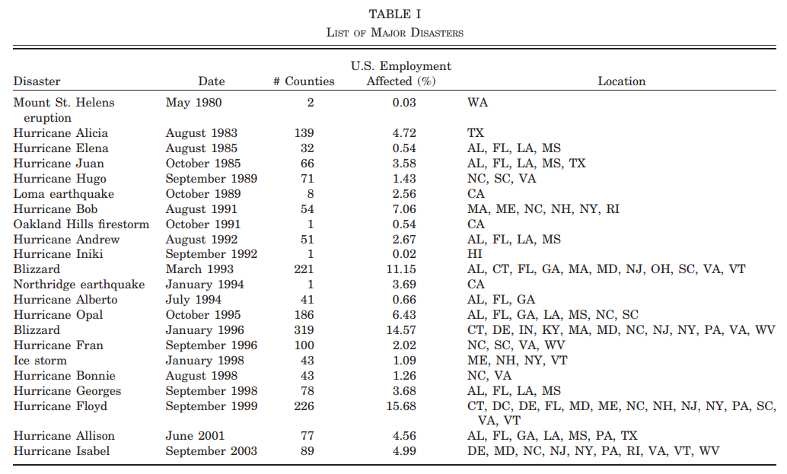

Slide 10
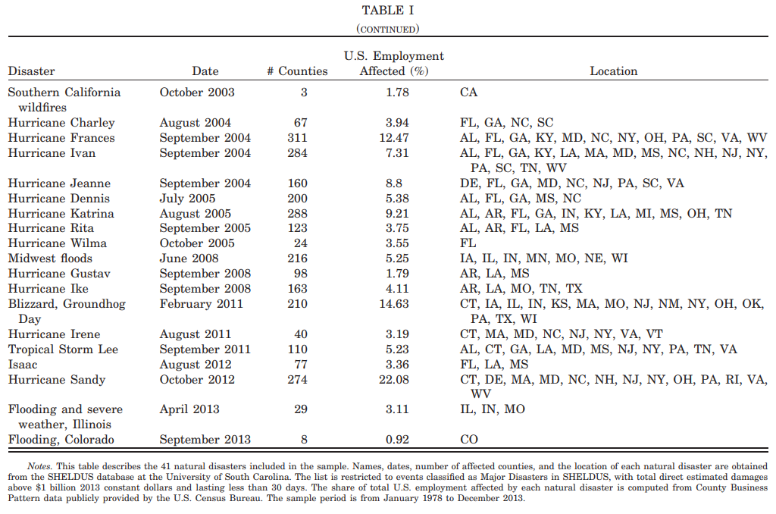

Slide 11
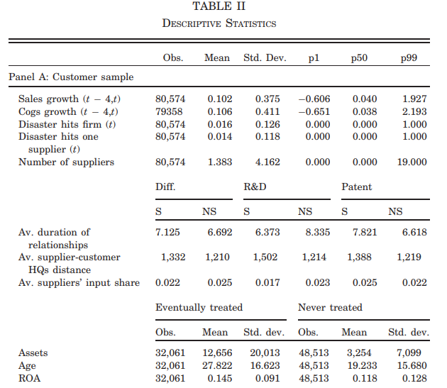
Notes:
Firms are observed over a period extending three years before and after their appearance in the Compustat Segment files.
On average, each customer firm has 1.38 suppliers, with supplier relationships lasting around seven years. The probability of a supplier being hit by a natural disaster in a given quarter is 1.4%, while the probability of a customer being hit directly is 1.6%.
Supplier sales represent approximately 2.5% of the customer firm's cost of goods sold, suggesting suppliers are relatively small compared to customers. There is no significant difference in the cost-of-goods-sold share between specific and nonspecific suppliers, and the average distance between suppliers and customers is over 1,250 miles, regardless of input specificity.

Slide 12
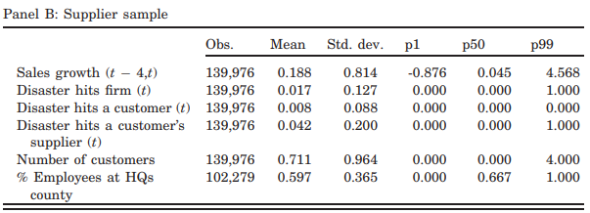
Notes:
Firms are observed over a period extending three years before and after their appearance in the Compustat Segment files.
On average, each customer firm has 1.38 suppliers, with supplier relationships lasting around seven years. The probability of a supplier being hit by a natural disaster in a given quarter is 1.4%, while the probability of a customer being hit directly is 1.6%.
Supplier sales represent approximately 2.5% of the customer firm's cost of goods sold, suggesting suppliers are relatively small compared to customers. There is no significant difference in the cost-of-goods-sold share between specific and nonspecific suppliers, and the average distance between suppliers and customers is over 1,250 miles, regardless of input specificity.

Slide 13
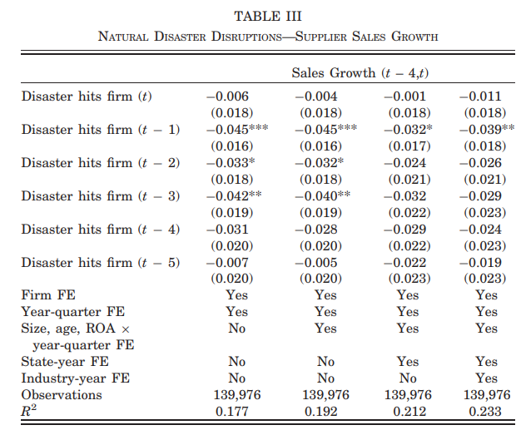
Notes:
The table shows that suppliers' sales growth significantly drops for up to three quarters following a natural disaster in their headquarters' county. This decline in growth is reflected by statistically significant coefficients for the quarters after the disaster, especially for quarter t−1t - 1t−1 (3.2% to 4.5% decrease) and quarter t−2t - 2t−2 (2.4% to 3.3% decrease).
The negative impact remains consistent across different specifications, even when controlling for firm characteristics (size, age, and ROA), state-year fixed effects, and industry-year fixed effects. This consistency implies that firm-specific factors and regional or industry-specific conditions do not drive the observed decrease in sales growth.
The persistence of the negative effect up to three quarters after the disaster suggests that natural disasters cause prolonged disruptions to affected suppliers, highlighting the vulnerability of these firms to exogenous shocks.

Slide 14
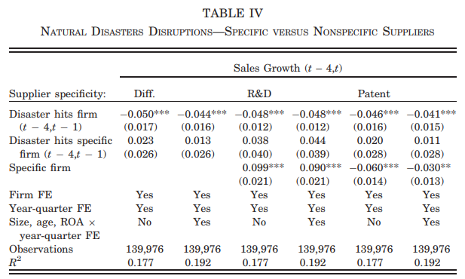
Notes:
The coefficient on the interaction term is always positive, although not statistically significant, which suggests that shocks to specific suppliers are, if anything, of smaller magnitude than shocks to nonspecific suppliers.

Slide 15
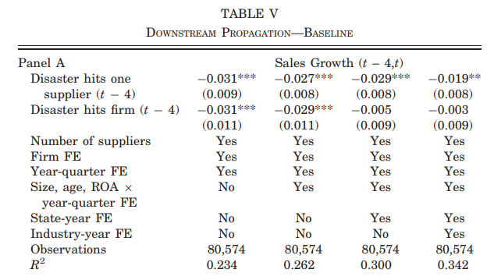
Notes:
Firms experience a significant decline in sales growth (3.1 percentage points) when one of their suppliers is hit by a natural disaster in the previous year, highlighting the extent of disruption that supplier shocks can cause downstream.
Direct Effect of Supplier Disruptions on Customer Sales Growth: Disruptions from natural disasters affecting a firm’s supplier lead to a 3.1% drop in the firm's sales growth on average, as indicated by the significant coefficient for “Disaster hits one supplier.” This baseline result demonstrates that shocks to suppliers have immediate adverse effects on firms’ sales performance.

Slide 16
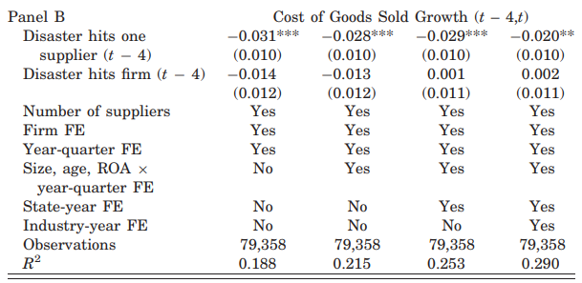
Notes:
Impact on Cost of Goods Sold (COGS): Panel B reveals that natural disasters also impact the growth in COGS for firms with affected suppliers, with reductions similar in magnitude to those in sales growth. This indicates that disruptions not only reduce revenue but also alter cost structures, likely due to adjustments in sourcing or production delays.

Slide 17
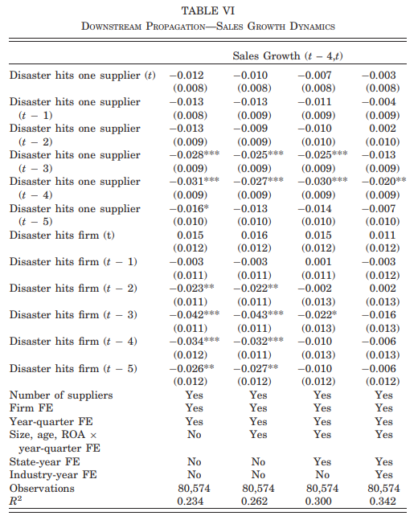
Notes:
Sales Growth Impact Over Time: Table VI examines the dynamic impact on a firm’s sales growth across various quarters after a supplier experiences a disaster. The results show a progressive decline in sales growth reaching a peak negative effect four quarters after the disaster event, with a statistically significant decrease of approximately 3% to 3.1%. This gradual worsening suggests that the disruption effect builds over time as the firm feels increasing operational impacts. Sustained Negative Effect: The findings indicate a sustained adverse impact on sales growth even beyond the immediate quarters following the disaster. The coefficients remain negative and significant in subsequent quarters (t+5), which implies long-lasting disruptions for firms dependent on affected suppliers. Resilience Factors: The analysis includes controls such as firm fixed effects, year-quarter fixed effects, and variables like firm size, age, and ROA. This ensures the results reflect the genuine impact of supply chain disruptions rather than general market or firm-specific trends, confirming the unique vulnerability tied to supply chain dependencies​(Barrot, Sauvagnat, 2016)

Slide 18
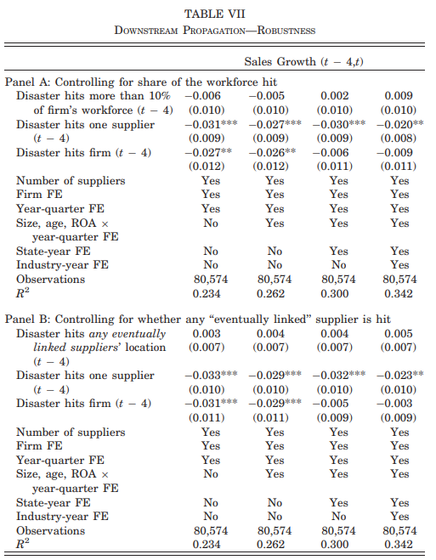
Notes:
Controls for Robustness Checks. One might be concerned that the results are driven by the location of customers’ plants close to the headquarters of their suppliers. In Panel A, Table VII, we introduce a dummy taking the value of 1 if more than 10% of the customer’s workforce across all establishments is hit by a natural disaster.
Another concern is that the estimates from Table V might reflect common demand shocks affecting the firm and its suppliers, for instance, because their customer base is located in the same area. To handle this issue, we augment our OLS regressions with a dummy called Disaster hits any eventually linked suppliers’ location, which takes the value of 1 if any headquarters’ county locations of all suppliers once in a relationship with the firm is hit by a natural disaster. Geographic and Economic Robustness: Panel A of Table VII tests if results are driven by the geographic proximity of firms and suppliers. Introducing a variable representing significant workforce impact in a disaster area confirms that proximity alone does not explain the sales decline, as the core relationship between supplier disruptions and firm sales remains stable. Control for Demand Shocks: Panel B assesses whether common demand shocks might drive the observed impact by adding a variable for any disaster hitting a connected supplier location. The stability of the coefficients for “Disaster hits one supplier” suggests that the impact is not merely due to regional demand shocks but rather specific disruptions in the supplier relationship.

Slide 19
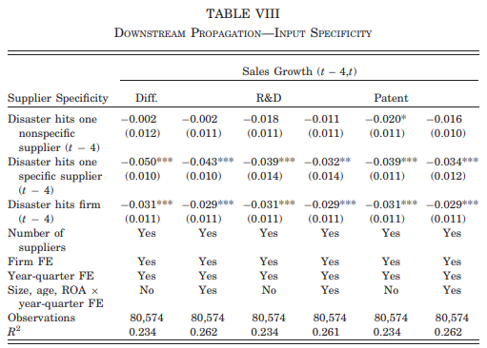
Notes:
Impact of Specific vs. Nonspecific Suppliers on Sales Growth: When a disaster hits a specific supplier, there is a significant negative impact on the firm's sales growth. The coefficients for specific suppliers (across different specificity measures like differentiation, R&D intensity, and patent intensity) range from -0.032 to -0.050 and are statistically significant. In contrast, nonspecific suppliers show negligible impact, with coefficients close to zero and often insignificant. This demonstrates that disruptions to specific suppliers have a pronounced downstream effect on firms' performance.
Role of Input Specificity in Shock Propagation: The table highlights how input specificity intensifies the effect of shocks. Specific suppliers, which are harder to replace due to their specialized nature, drive the propagation of adverse impacts from supplier disruptions to downstream firms. This result underscores the risks associated with dependencies on specific, specialized suppliers in the supply chain.
Control Variables and Robustness: The analysis includes controls for firm and year-quarter fixed effects and various firm-level characteristics such as size, age, and return on assets (ROA). These controls help isolate the effect of supplier-specific shocks on sales growth. The robustness of the results across different specifications strengthens the conclusion that specific suppliers are critical conduits for downstream propagation of supply shocks​(Barrot, Sauvagnat, 2016).

Slide 20
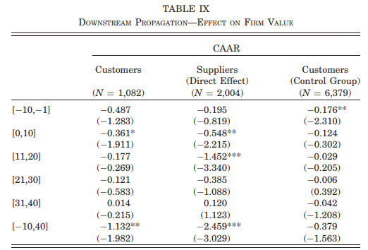
Notes:
Cumulative Abnormal Returns (CAAR) for Customers and Suppliers: The table presents CAAR for customers, suppliers, and control firms over different event windows around disasters. Results show that customers of affected suppliers experience a drop in CAAR, with significant decreases within the 21-day window surrounding the disaster, indicating that investors quickly react to the impact of supplier disruptions.
Long-term Impact on Suppliers: Directly affected suppliers experience a significant negative CAAR over the 51-day event window, which is larger in magnitude compared to customers. This suggests that suppliers hit by disasters face substantial financial losses that are prolonged over time.
Control Group Comparison: The control group, representing firms with unaffected suppliers, shows minimal or no significant CAAR changes. This highlights that the negative effect on CAAR is specific to firms with affected suppliers, supporting the conclusion that supply chain disruptions directly harm firm value only in impacted networks​(Barrot, Sauvagnat, 2016).

Slide 21
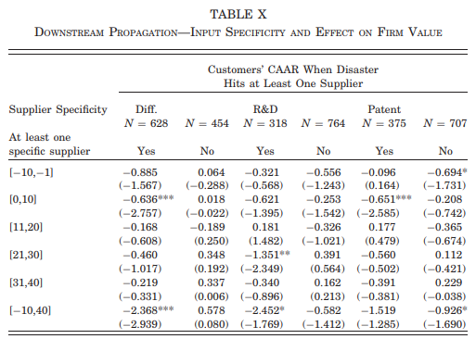
Notes:
Greater Impact of Disruptions from Specific Suppliers: When specific suppliers (defined by product differentiation, R&D intensity, or patent holdings) are hit by a disaster, customer firms experience a significantly larger CAAR drop compared to nonspecific suppliers. This highlights that input specificity amplifies the financial impact of supply chain disruptions.
Investor Sensitivity to Supplier Specificity: Stock prices react more negatively for firms reliant on specific suppliers, indicating that investors perceive specific suppliers as harder to replace, thus leading to higher perceived risk and greater valuation losses for affected firms.
Consistency Across Specificity Measures: The results are consistent across different measures of specificity, such as differentiation, R&D spending, and patent intensity, reinforcing the robustness of the finding that specific suppliers' disruptions significantly impact firm value

Slide 22
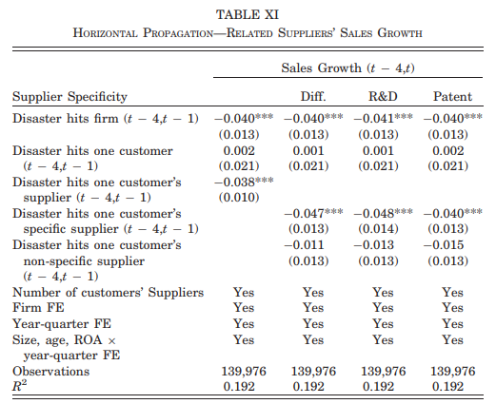
Notes:
Impact on Sales Growth of Related Suppliers: When a disaster affects a firm, related suppliers who serve the same customers also experience negative sales growth. This table shows that if a specific supplier of a common customer is hit by a disaster, other suppliers tied to that customer experience a 4% decrease in sales growth. This highlights the indirect, horizontal propagation effects across suppliers connected through a mutual customer.
Stronger Impact from Specific Suppliers: Disasters impacting specific suppliers (those with high R&D or patent intensity) lead to a larger negative effect on other related suppliers compared to nonspecific suppliers. This underscores that horizontal propagation is more pronounced when the disrupted supplier plays a critical, specialized role within the supply chain. Robustness of Results Across Specifications: The regressions include controls for firm fixed effects, year-quarter fixed effects, and various firm characteristics. The significant results across these controls suggest that the horizontal propagation effects are robust and not merely due to common shocks affecting the industry or location​(Barrot, Sauvagnat, 2016).

Slide 23
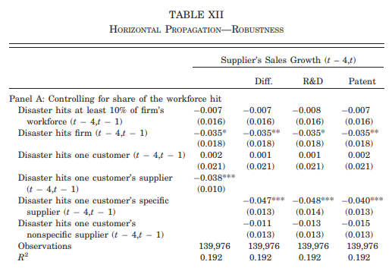
Notes:
Geographic Proximity Does Not Drive Results: The robustness checks in Table XII (Panel A) address the concern that results could be driven by the physical proximity of suppliers. By including a variable to account for when 10% or more of a supplier’s workforce is affected by a disaster, the analysis finds that the initial horizontal propagation effects remain significant, indicating that proximity alone is not responsible for the observed impact.

Slide 24
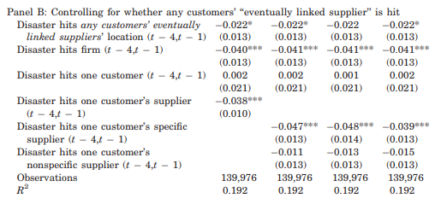
Notes:
Validation Against Common Customer Demand Shocks: Panel B tests whether the results might stem from common demand shocks among suppliers. It includes a variable representing disasters hitting any customer-related supplier location. The consistent effects, even after including this variable, suggest that the observed impact is indeed due to active economic links and not simply common demand shocks in specific locations.

Slide 25
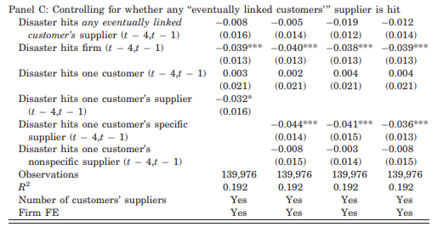
Notes:
Industry-Wide Shocks Are Not the Cause: Panel C includes a control for common industry shocks by adding a dummy for disasters hitting any eventually linked supplier. The fact that the primary results persist indicates that industry-wide shocks do not account for the horizontal propagation observed in the data. This supports the idea that economic linkages specific to the supply chain relationships are key in propagating the impact of shocks​(Barrot, Sauvagnat, 2016)​(Barrot, Sauvagnat, 2016).

Slide 26
Conclusion
Idiosyncratic shocks, especially those affecting specific and non-substitutable inputs, significantly propagate through production networks, impacting downstream and even peer firms.
Input specificity plays a crucial role in determining the extent of these disruptions, highlighting the economic importance of relationship-specific investments and the potential costs of switching suppliers.
Findings suggest that firms heavily reliant on specific suppliers face higher risks of financial loss and operational disruptions.

